Slide 1
Weather Web-app
Project
Spring 2024 (Even)

Slide 2
GEO LOCATION
TABLE OF CONTENTS
01
02
03
LIVE WEATHER
ANIMATION
04
05
06
BACKEND
PERFORMANCE REPORT
ABOUT ME

Slide 3
Let’s Start Frontend
Tech Stack for Front End — React JS

Slide 4
Front End
A
Front End is made using React JS

Slide 5
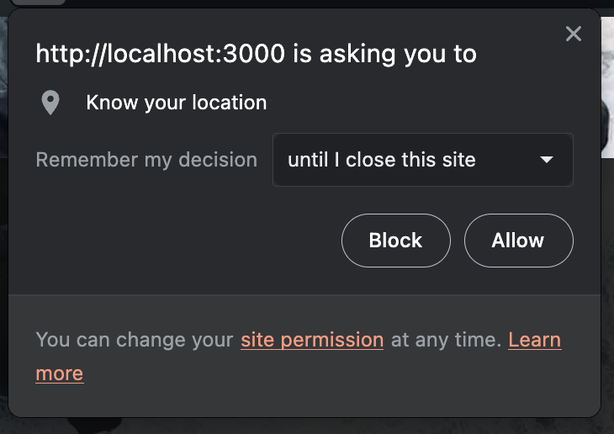
Getting User Location !!
Taking Live User Location using navigator.geolocation in React JS

Slide 6
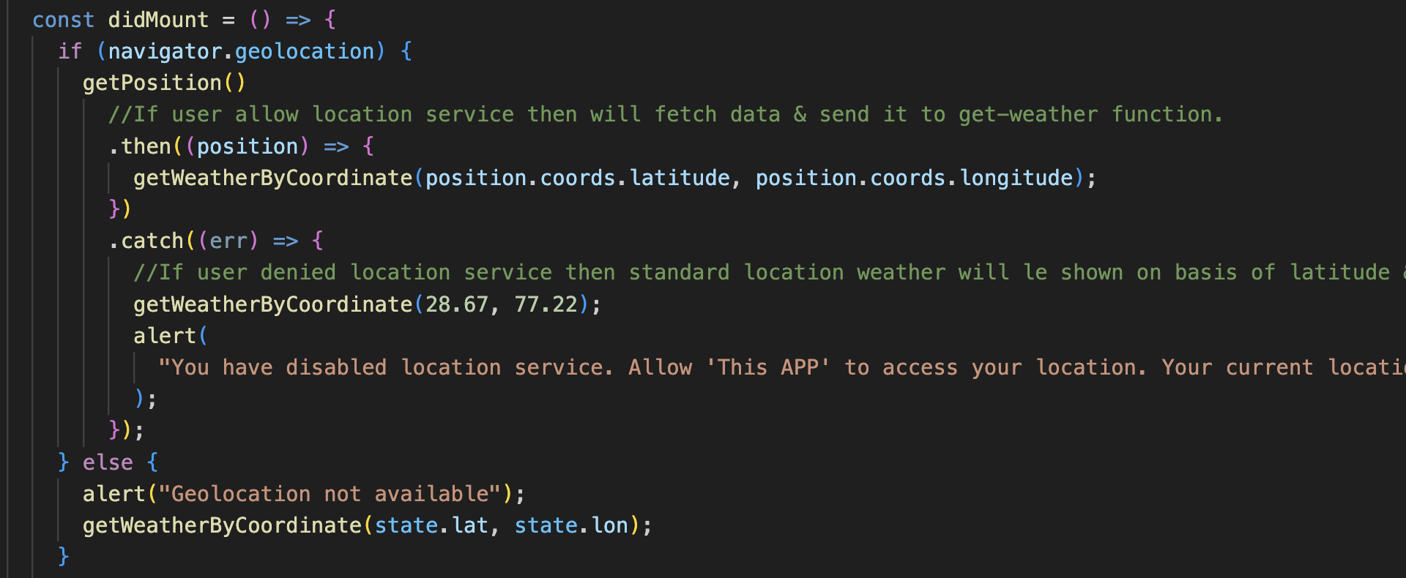

Slide 7
SERVICES
METEOROLOGICAL
HYDROLOGICAL
WebApp presents Live Temperature of Your City
WebApp presents Live Humidity of the City

Slide 8
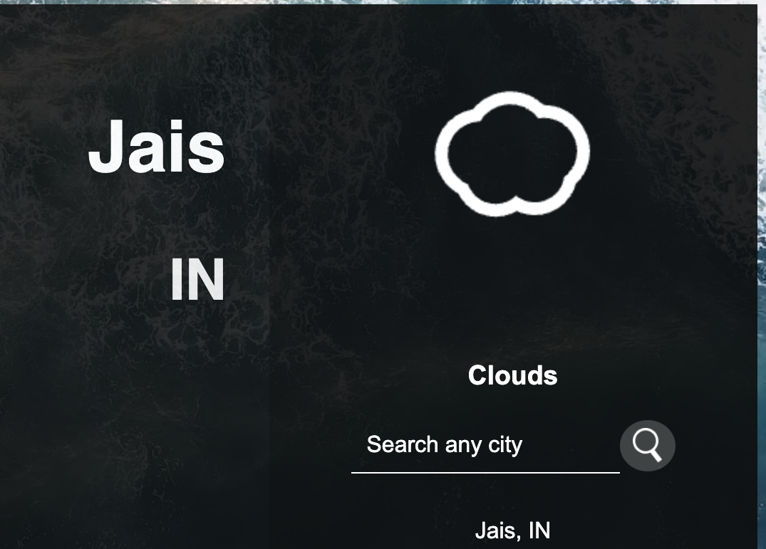
Animation

Slide 9

DESKTOP MOCKUP

Slide 10
METEOROLOGICAL INFOGRAPHIC
PARTIAL
CLOUDY
CLOUDY
WIND
CLEAR_DAY
RAIN
SNOW

Slide 11
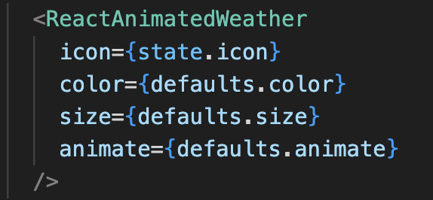

Slide 12
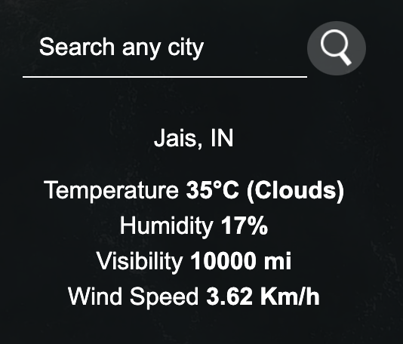
SEARCH BAR

Slide 13
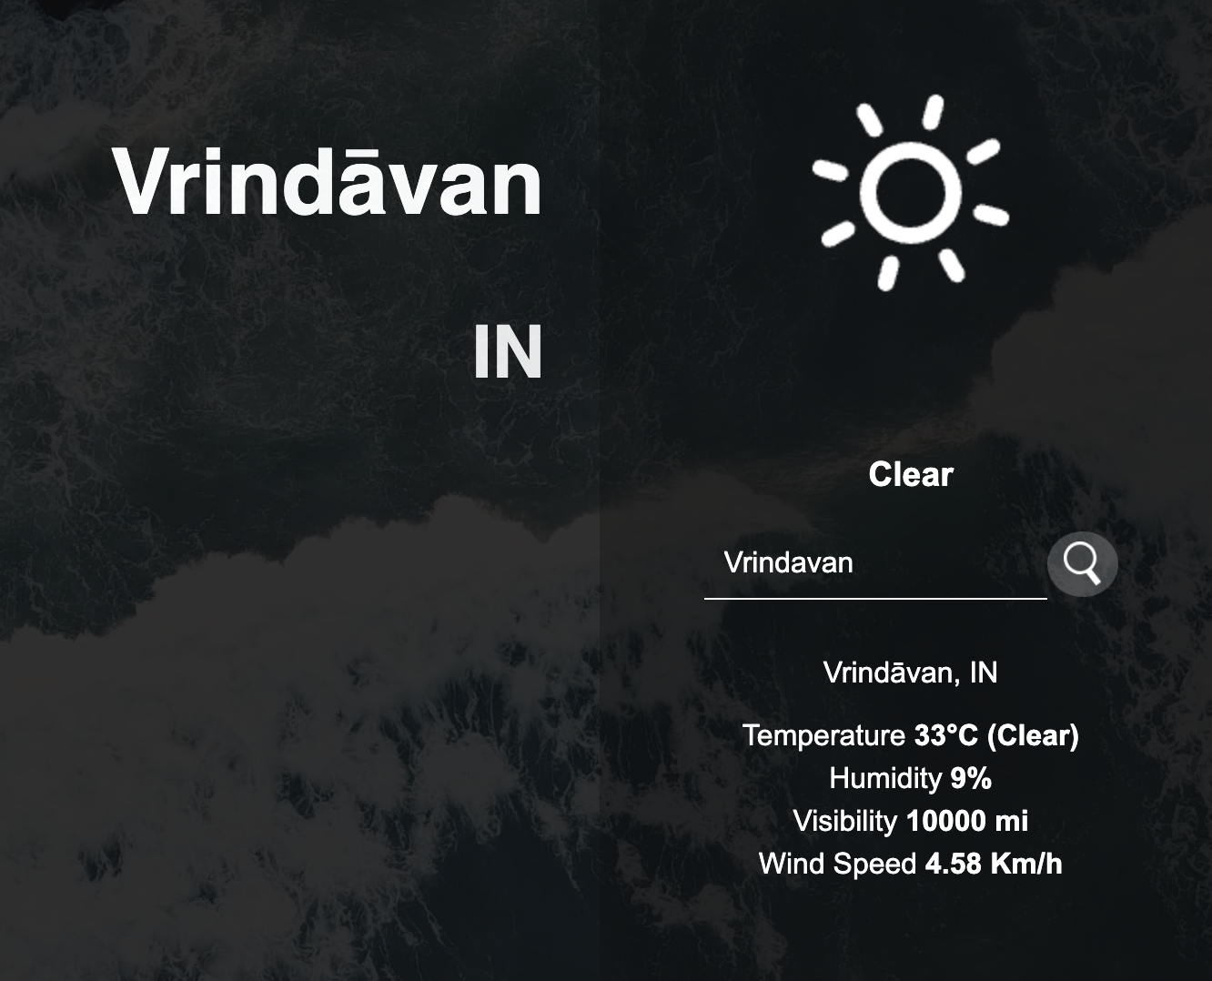

Slide 14
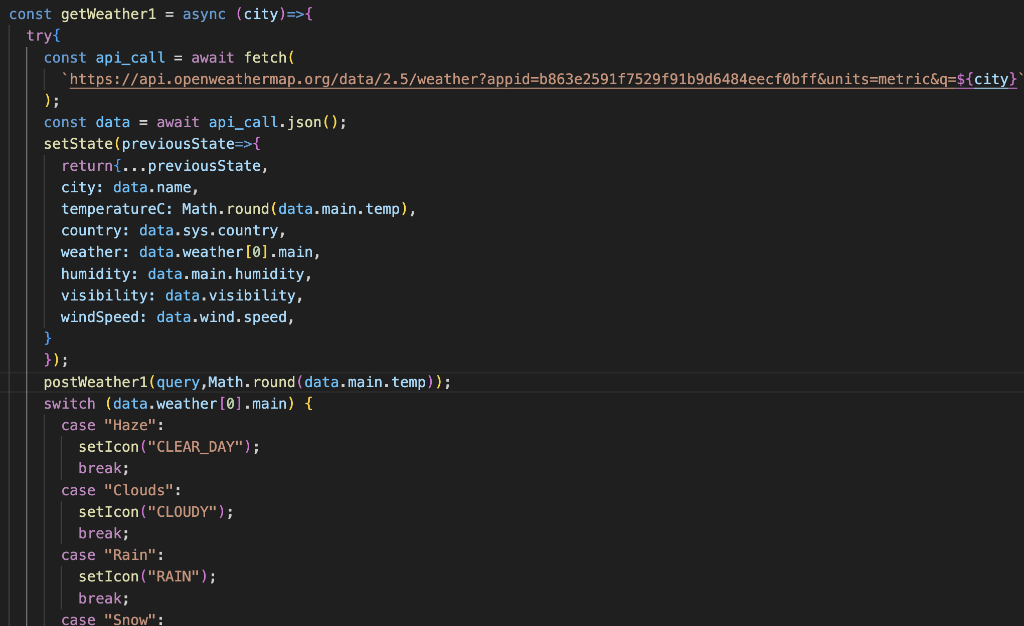
Fetch Code

Slide 15
BACKEND
B
Tech Stack — NODE JS
EXPRESS JS
MONGO DB

Slide 16
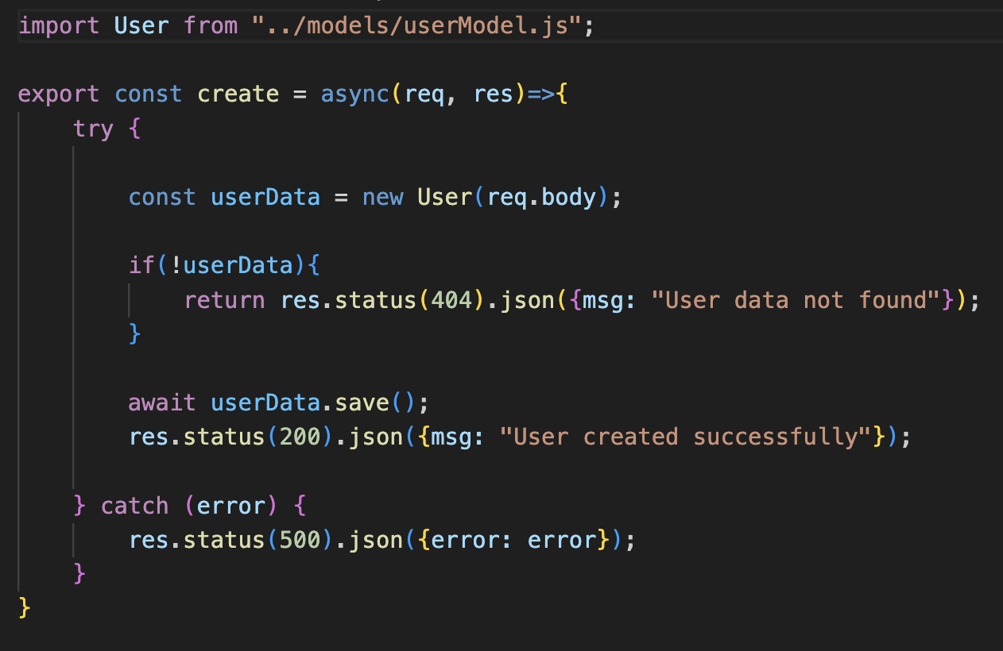
Controller

Slide 17
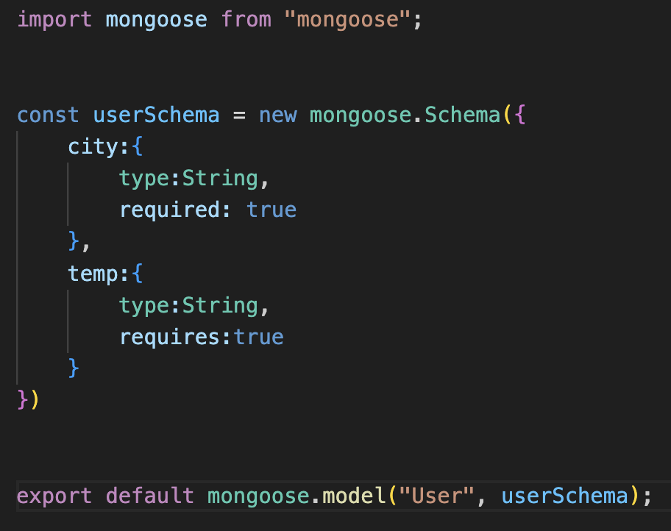
USER MODEL

Slide 18
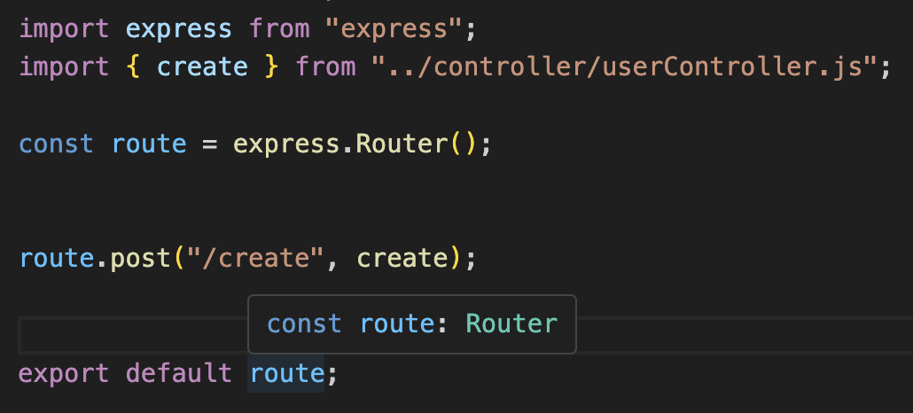
USER ROUTES

Slide 19

Data Base

Slide 20
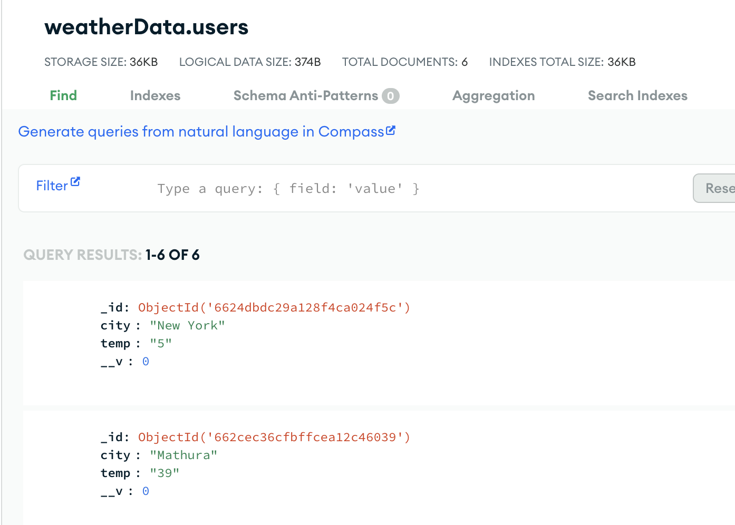
DATABASE SCREENSHOT

Slide 21
PERFORMANCE REPORT
C
Another File

Slide 22
AWESOME WORDS

Slide 23

ABOUT
Tejash Singh
22CD3032

